Slide 1
Module Design Pattern
@ShankaragoudaG
The Module pattern was originally defined as a way to provide both private and public encapsulation for classes in conventional software engineering.
Another peculiar thing to JavaScript (at least as far as object-oriented languages go) is that JavaScript does not support access modifiers.
In a classical OOP language, a user defines a class and determines access rights for its members.

Slide 2
Different ways to Implement Modules
The Module pattern
Object literal notation
AMD modules
CommonJS modules
JavaScript modules

Slide 3
Module Pattern built on four principal member types
public: members that can be accessed from anywhere
private: members that can only be accessed from inside the object
privileged: members that can only be directly accessed from inside the object, but which can be indirectly accessed from outside via a public method
protected: members that can only be accessed from inside the object or any of its modules.

Slide 4
Module Design Pattern Benefits
Freeze the scoping.
Code encapsulation.
Creating private or public scope.
Creating a namespace.
Creating public and private encapsulation.

Slide 5
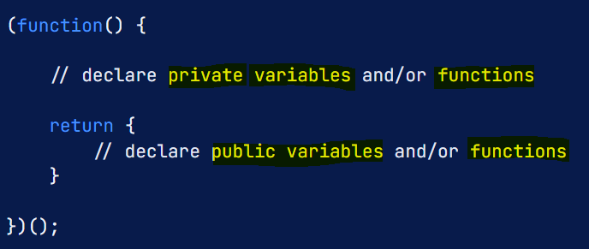
Module Design Example
@ShankaragoudaG
We can implement a module pattern using JavaScript Object Literals and Immediately-Invoked function expressions(IIFE).
Here you can see declaring
Private and Public Members

Slide 6
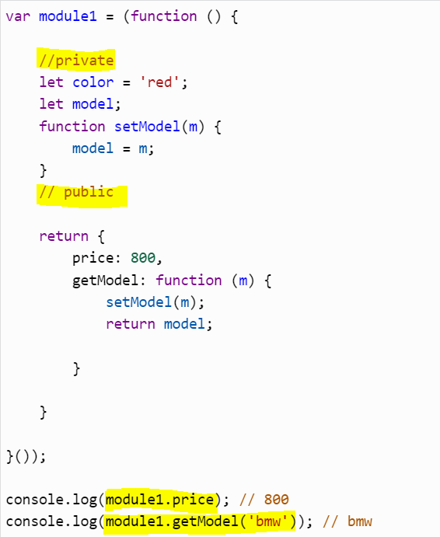
Module Design Example
@ShankaragoudaG
We can export the module by assigning it to a variable using an expression and then creating private and public encapsulation using the return statement.
Module pattern emulates classes
in JavaScript.
It creates private and public
encapsulated variables by
returning an object.
It encapsulates privacy using
Closures.

Slide 7
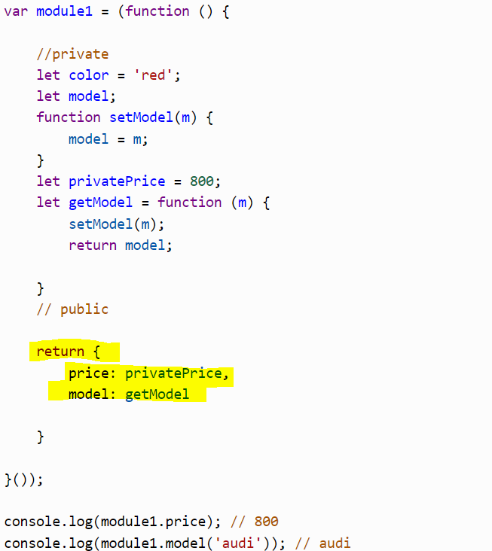
The Revealing Module Pattern
The Revealing pattern helps
to write the entire object logic
in the private scope of the
module and then simply
expose the parts
we want to be public by
returning an anonymous
object.

Slide 8
Useful Resources
https://www.patterns.dev/posts/classic-design-patterns/#modulepatternjavascript
https://www.oreilly.com/library/view/learning-javascript-design/9781449334840/ch09s02.html

